Slide 2
About Me:
Photography's the game, V's the name. I am 16 years old, and currently a sophomore in High School. I have been taking photos my whole life, and recently in the past few years I have been drawn to it more and more. I have taken classes for just over a year now, and I teach photography to grades 6-8 at my local junior high, after school. Some fun facts about me would be that I am a cheerleader, teach CCD classes, and, of course, my passion is photography. One unique thing that most people do not know about me is that I am legally blind with no vision in my right eye, and a small pinpoint in my left. I have been told I see almost a new dimension. I am perfect for the camera because I see the world in a new perspective, and can deliver the absolute best for all of my clients. I do photography so that I can capture someone else's moments for them to last a lifetime. I hope that you consider me to be your next photographer!!!

Slide 3
What is Photos By V?
Photos By V is a photography company. We deliver the best quality of photos that you can imagine. By choosing Photos By V, each time you hire us we donate a portion of the proceeds to charity. This way, you get the best of the best while doing good for the community.

Slide 4
Mission Statement:
Our mission is to provide your family with happiness while reaching out to the community from one family to another.

Slide 5
Vision Statement:
Our vision is to make Photos By V your go to photographer while providing you with various opportunities to help the less fortunate.

Slide 6
Motto:
Capturing each precious
moment in your life.

Slide 7
Values:
Helping the less fortunate
Providing the best quality for the buyer
To capture the happiness in each individual

Slide 8
Why Photos By V?
We reach out to the community while being able to capture the moments of each family and/or person. We want to make sure that we help you remember each moment of your life whether it is sad, happy, or both, we will stand by your side. No matter what. We treat each person as if they are family because nothing is more important, right?

Slide 9
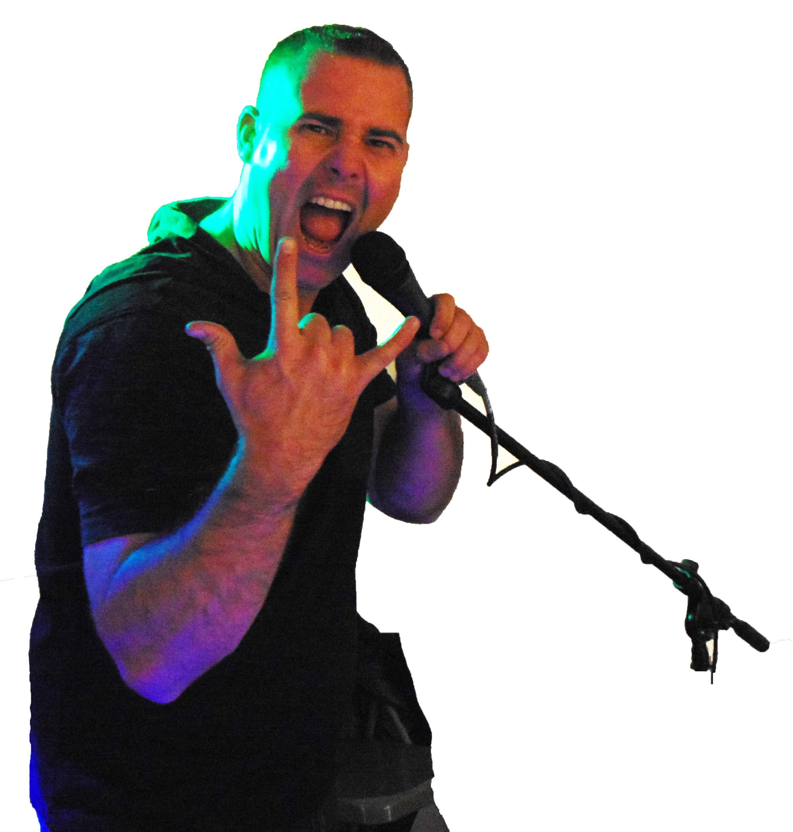
Partnered with J.A.M. DJing Services
Check out his FB page and Instagram!!

